Slide 1
Plants Around Us

Slide 2
When you visit a park or a garden, what do you see ?

Slide 3
We see many colourful
flowers ,plants and trees.

Slide 4
There are many kinds
of plants around us.
Some plants are big and some are small. Some plants
Grow straight. Other plants grow straight and spread out.

Slide 5
LET’S LEARN ABOUT DIFFERENT TYPES OF PLANTS

Slide 6
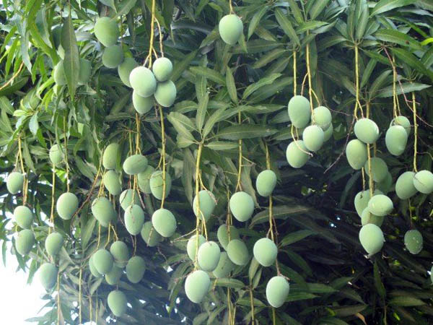
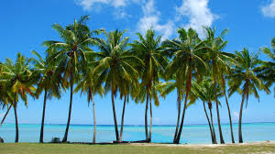
Trees
They are tall and strong plants. They have thick
stems called trunk.
For example:
Mango tree, Coconut tree

Slide 7
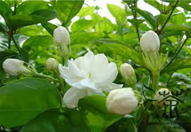
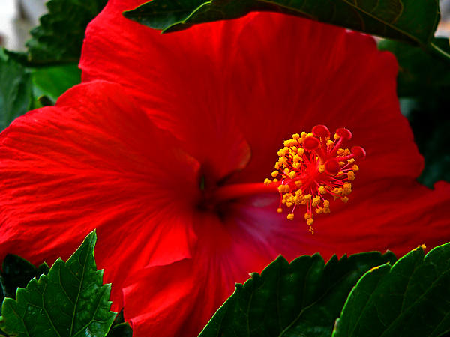
Shrubs
They are small and bushy plants. They have brown, thin and strong stems.
For example:
Jasmine, Hibiscus.

Slide 8
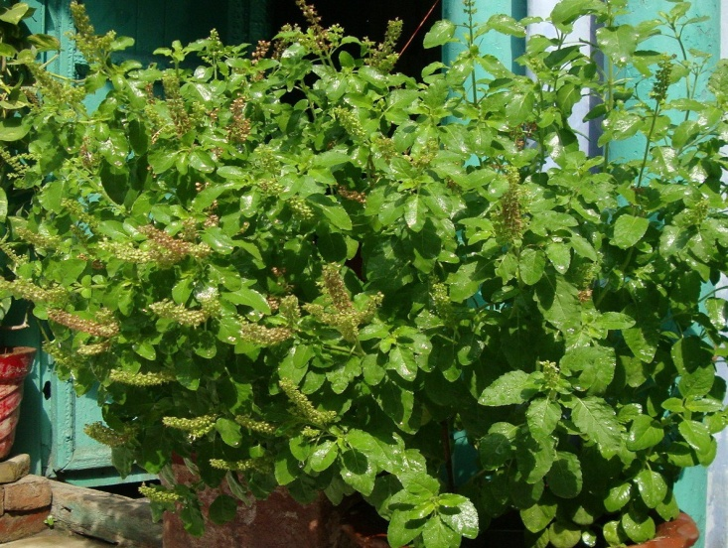
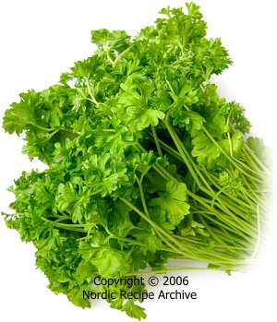
Herbs
They have small and soft stems.
For example:
Basil(tulsi), coriander.

Slide 9
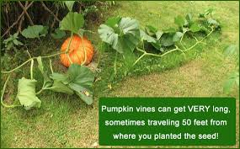
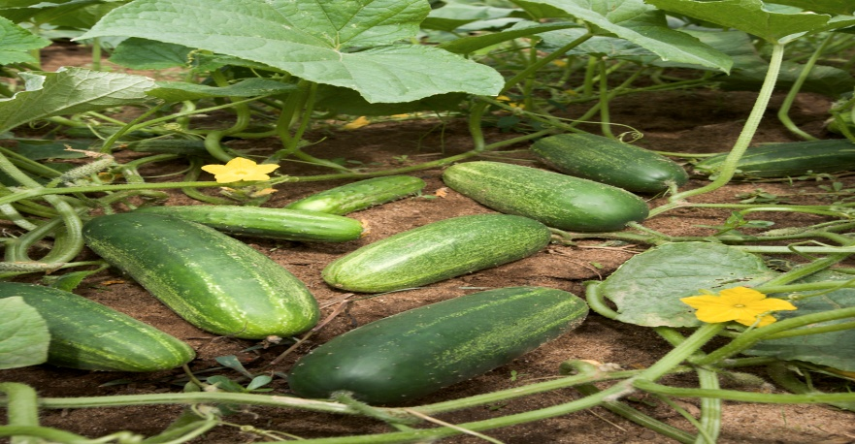
Creepers
These plants grow along the ground. They have very weak stems.
For example:
Pumpkin, Cucumber.

Slide 10
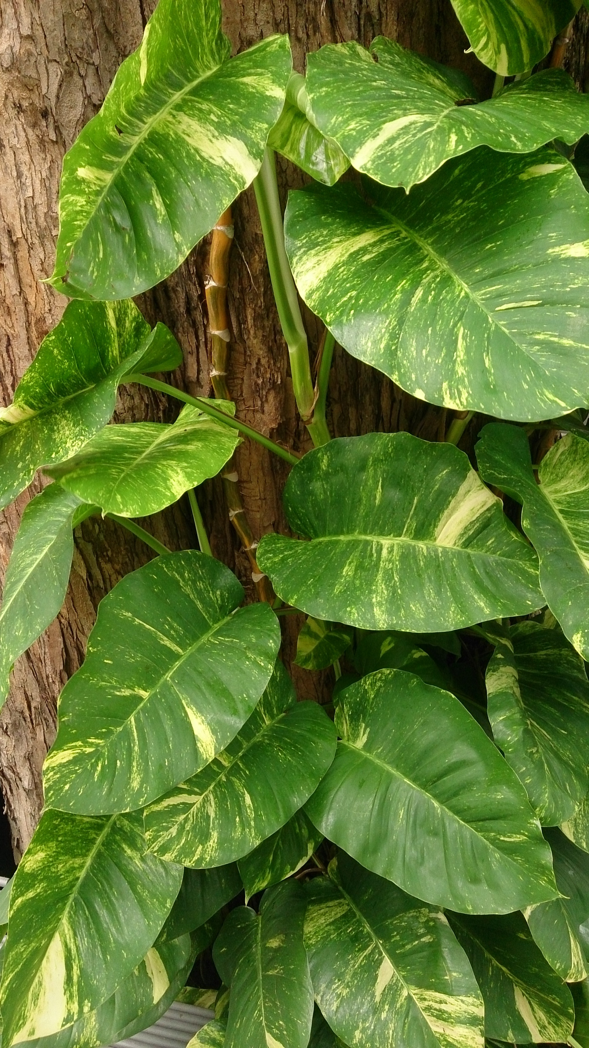

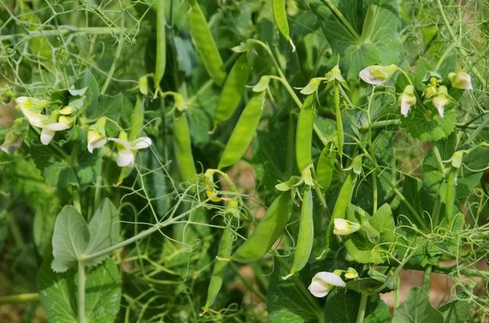
Climbers
These plants need support to
grow as they have weak stems.
For example:
Money plant, pea plant

Slide 11
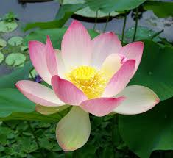
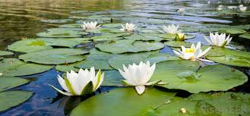
Aquatic Plants
These plants grow in water.
For example:
Lotus and Water lily.

Slide 12
Interesting Facts
Some plants like roses and cacti have thorns.
Cactus grows in places where there is very little water.

Slide 13
Think and tell
Tanvi’s father wants to grow watermelon.He has put watermelon seeds in the ground. Why did he not put the seeds in the pot?

Slide 14
Created by:
Ms.Rachna Yadav
Ms.Monika Guha Roy
Ms.Poonam Misra
Ms.Jayati Wahal

